Slide 1


2057 Demographic Methods
Practical 1:
Population Composition and Demographic Rates
02/10/2025

Slide 2
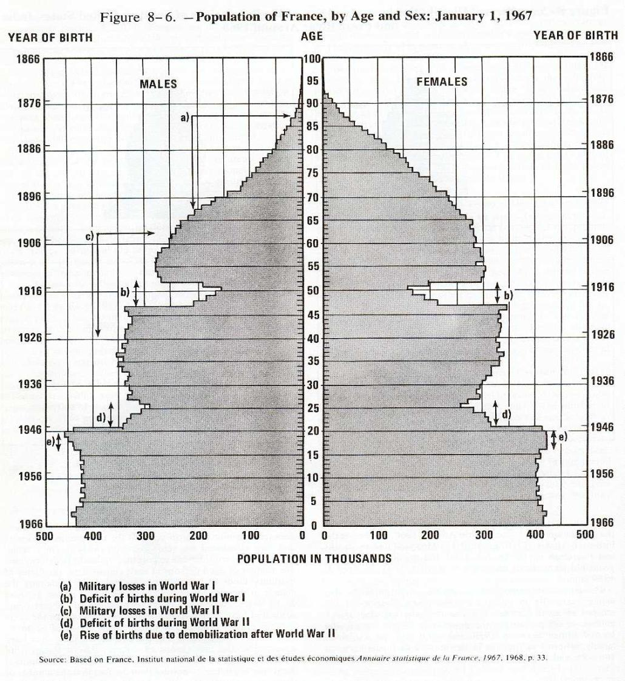
1. Population Pyramid: France 1967
Military losses in WW1
Military losses in WW2
Deficit of births during WW1
Deficit of births during WW2
Rise of births due to demobilization after WW2

Slide 3
1. Population Pyramid: France 1967
Military losses in WW1
Is the male-to-female sex ratio around 1.05?
Military losses in WW2
Deficit of births during WW1
Deficit of births during WW2
Rise of births due to demobilization after WW2

Slide 4
2. Balancing Equation and Rates
The following rates were recorded for a fictive population: CBR: 0.0145; CDR: 0.0078; CGR: 0.0085. Compute the Crude Rate of Natural Increase (CRNI) and the Crude Rate of Net Migration (CRNM).
CRNI=CBR-CDR=.0145-.0078 = .0067 (0.67 percent or 6.7 per 1,000)
CRNM=CGR-CRNI=.0085-.0067=.0018 (0.18 percent or 1.8 per 1,000)

Slide 5
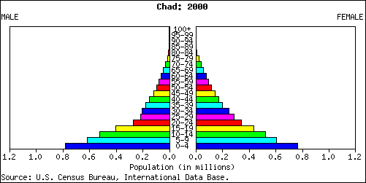
3. Sketch the population age pyramids of the following populations
a. A population with high fertility and high mortality:
A population age structure with a pyramidal shape: a wide base with large reductions in the number of people from one age group to the next.

Slide 6
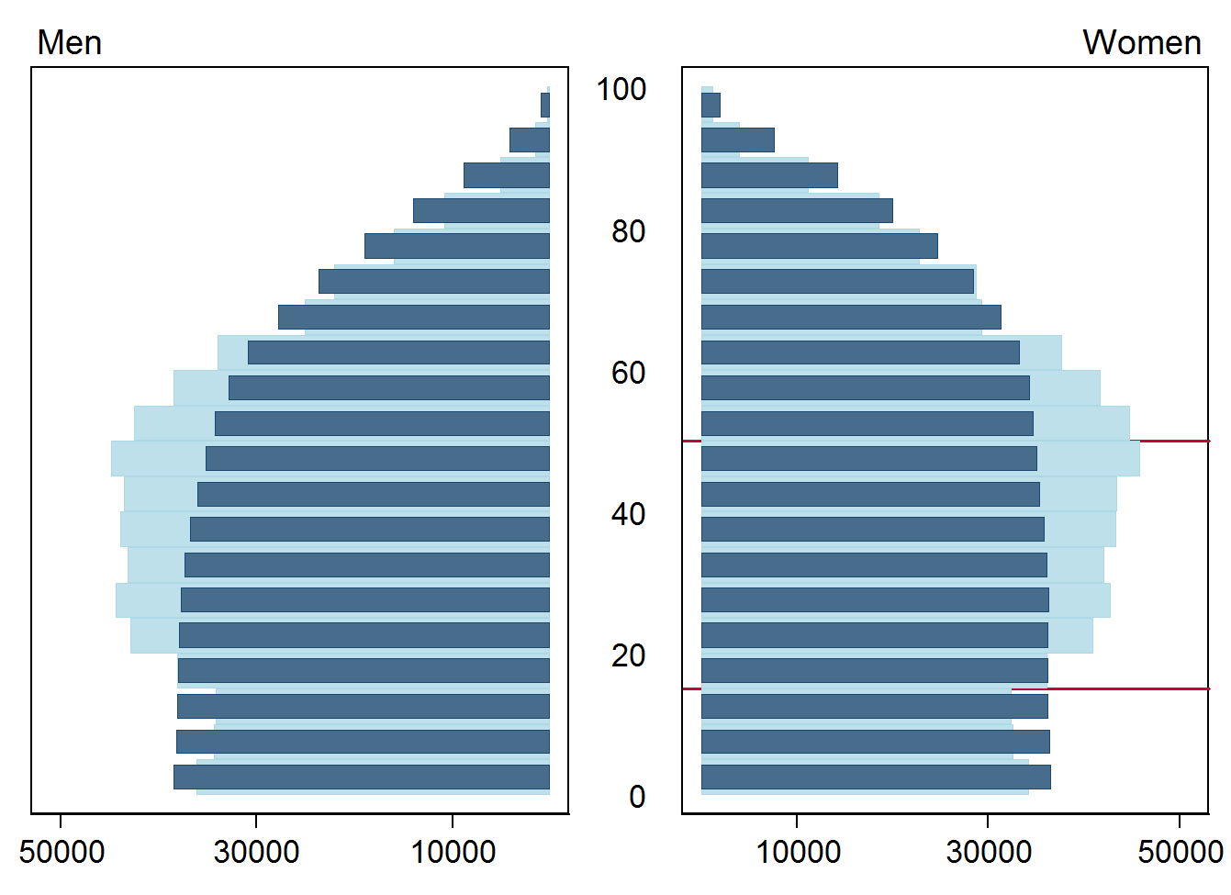
3. Sketch the population age pyramids of the following populations
b. A stationary population with relatively low fertility and low mortality:
(A stationary population is a population that is neither growing or shrinking: Crude Growth Rate, CGR = 0) …rectangular shape!

Slide 7
3. Sketch the population age pyramids of the following populations
A stationary population with relatively low fertility and mortality (dark blue):
hypothetical population age structure for high income countries–if they would retain the current mortality rates and “replacement-level” fertility rates for >100 years.
*Replacement fertility is the necessary level for each generation to replace itself (i.e., to sustain population numbers). This concept will be discussed in greater detail later in the course.

Slide 8
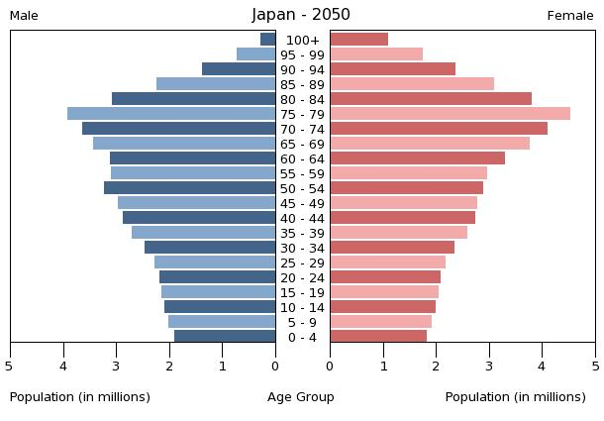
3. Sketch the population age pyramids of the following populations
c. A declining population with very low fertility rate:
An inverted pyramid, with a narrow base and wider top.
A shrinking population with very low fertility!

Slide 9
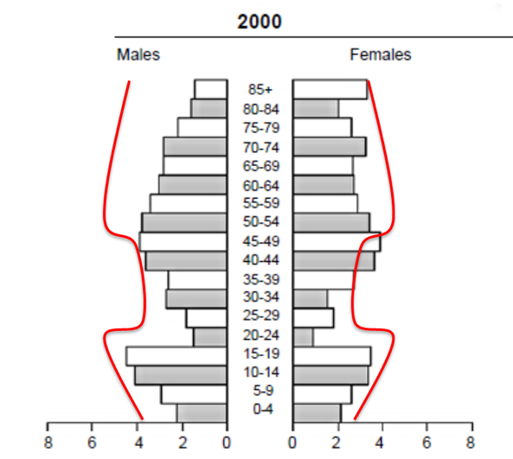
3. Sketch the population age pyramids of the following populations
c. A population that has experienced high emigration in the last 5 years among ages 20-40 years:
A dented pyramid, High emigration for 20–40-year-olds: a ‘bite’ taken out of the pyramid in the 20-40 age range for both sexes with knock-on effect of slight narrowing of the base of the pyramid as births decline (20-40 are the reproductive age groups)

Slide 10
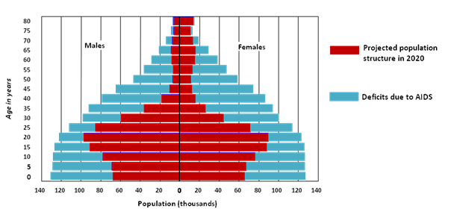
2. Sketch the population age pyramids of the following populations
e. A low-income country population that has extremely high rates of HIV/AIDS mortality among adult population:
Similar to d) with a ‘bite’ taken out of the population for those of reproductive age, and knock on effect of a slight decline in fertility

Slide 11
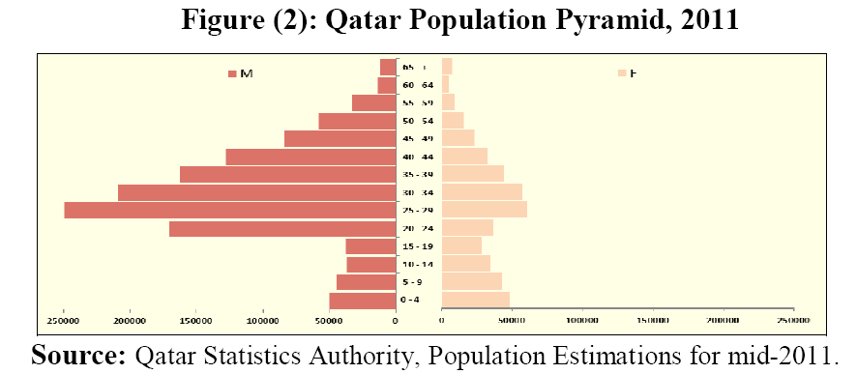
3. Sketch the population age pyramids of the following populations
f. What will happen to the population of a country after ten years, if a large male immigration has occurred among ages 25-45 years? Sketch the population age pyramid.
An excess of male 35–55-year-olds plus a slight narrowing of base of pyramid (but less noticeable than if migration had occurred among female population)…

